Slide 1
E-commerce Customer Data for Behavior Analysis

Slide 2
Name | Roll Number
Ashwin Ravi | 3122215001014
Deepti Gowtham | 3122215001023
Gayathri Venkatesan | 3122215001026
Karthik Vijaykumar | 3122215001040

Slide 3
Problem Statement and Domain
PROBLEM STATEMENT:
Develop a system to understand customer behavior for better predictions, segmentation, personalization, and increased customer value.
The solution should involve developing advanced predictive models, implementing robust data collection and integration mechanisms, and addressing ethical considerations.
The goal is to leverage customer data for predictive models, segmentation, personalization, and boosting customer satisfaction/loyalty/profitability.
DOMAIN:
Customer Relationship Management (CRM) with a focus on Marketing Analytics

Slide 4
Objective of the project
To develop predictive models, segmentation strategies, and personalized marketing initiatives that enhance customer satisfaction, loyalty, and long-term profitability by understanding and predicting customer behavior for future purchases in the realm of customer relationship management (CRM) and predictive analytics in e-commerce.

Slide 5
Development Environment
Python programming language served as the foundation for the project development.
Essential libraries such as pandas, NumPy, NLP, Keras, scikit-learn, seaborn, and Matplotlib were employed for various tasks including data manipulation, numerical computing, natural language processing, machine learning, model evaluation, and data visualization.
Google Colaboratory was utilized as the primary development environment, offering seamless collaboration among team members and access to powerful computing resources for efficient experimentation and iteration throughout the project lifecycle.

Slide 6
Overall System Overview
The overall system architecture can be described in the following flow diagram. First we collect the data, then we engineering the features and based on that we create a model that would be suitable for the problem. After evaluating the model, we can interact with it in the cloud using docker.

Slide 7
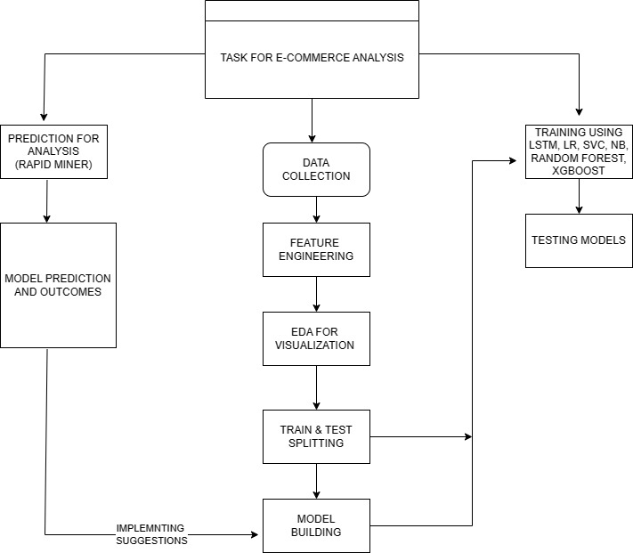

Slide 8
Steps to build the model

Slide 9
Steps
Importing Libraries
Data Loading and Preprocessing
Data Exploration
Data Distribution among classes
Training LSTM Model

Slide 10
Steps
Comparison with other models- Logistic Regression, Naive Bayes, Support Vector Classifier, Random Forest, XGBoost Classifier
Comparison of Performance Metrics-Accuracy, Confusion Matrix, ROC - AUC curves

Slide 11
Results and Inferences

Slide 12
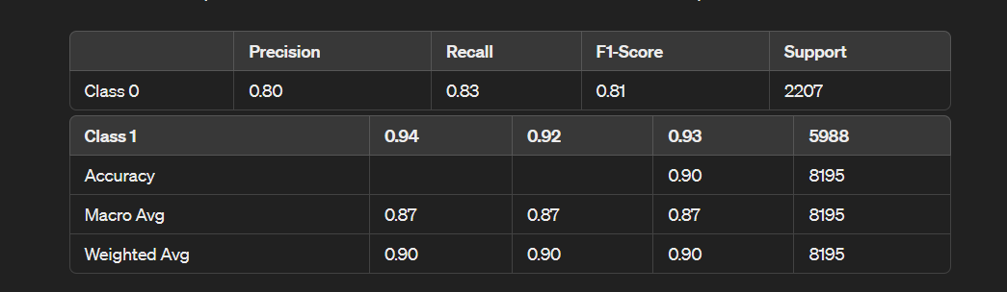
LSTM MODEL

Slide 13
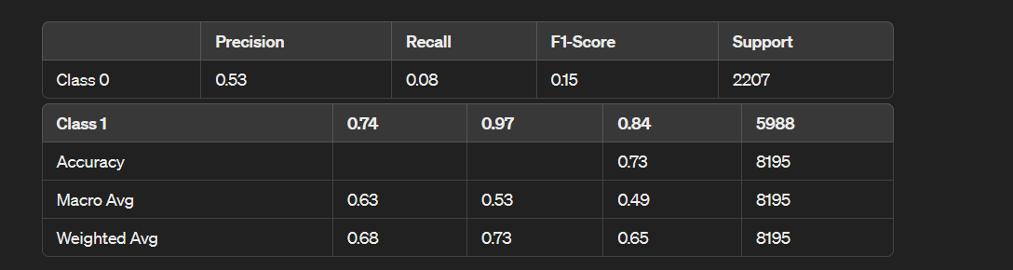
Logistic regression

Slide 14
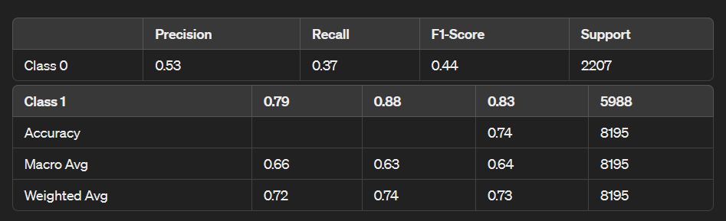
Naive bayes

Slide 15
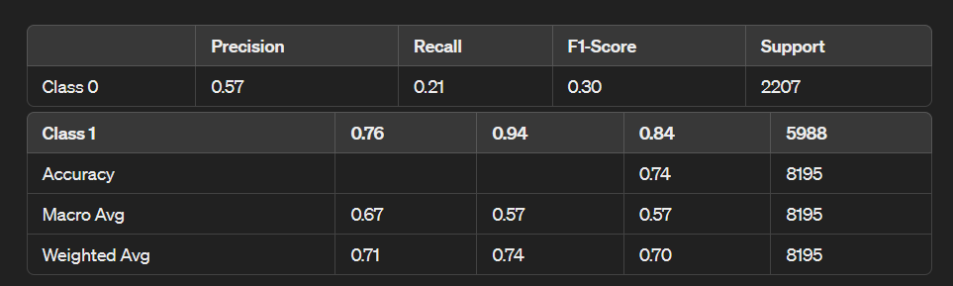
SUPPORT VECTOR CLASSIFIER (SVC)

Slide 16
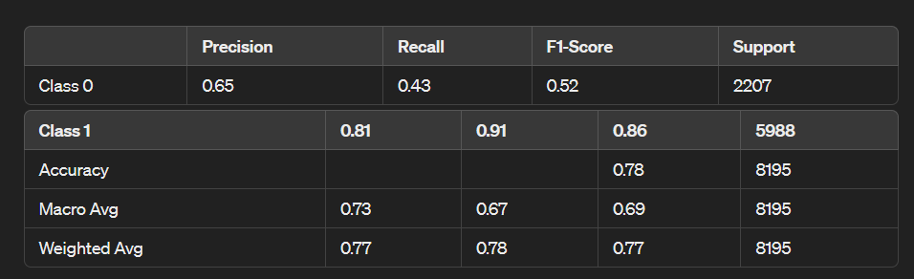
RANDOM FOREST CLASSIFIER

Slide 17
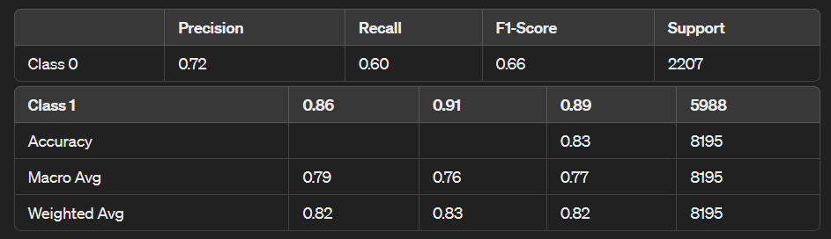
XG BOOST CLASSIFIER

Slide 18
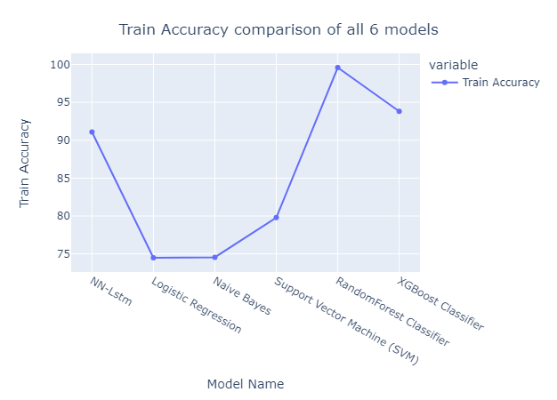

Slide 19
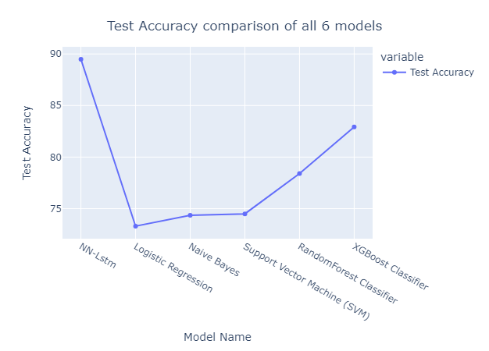

Slide 20
INFERENCE
The LSTM model achieved the highest accuracy of approximately 89.69% on the test data, indicating its effectiveness in distinguishing between different classes within the dataset.
Both precision and recall are high for class 1 (positive class), suggesting that the model effectively identifies instances belonging to this class.
The F1-score, which balances precision and recall, is high for both classes, indicating the LSTM model's suitability for this classification task.
Compared to traditional machine learning models, the LSTM model demonstrates superior performance, achieving the highest accuracy, precision, recall, and F1-score on the test data, making it the most effective for predicting customer behavior and future purchases based on behavioral analysis.

Slide 21
Impact of project

Slide 22
Impact
Enhanced Customer Satisfaction: Understanding customer sentiment allows businesses to tailor products and services to meet evolving demands effectively, leading to higher levels of customer satisfaction.
Trust Building: By analyzing customer reviews and feedback, companies can foster trust in online platforms, encouraging more individuals to embrace online shopping with confidence, thereby strengthening the integrity of digital commerce.
Proactive Adaptation: Sentiment analysis enables businesses to proactively anticipate shifts in preferences and adjust strategies accordingly, staying ahead of the curve and fostering innovation and competitiveness within the e-commerce landscape.
Positive Societal Outcomes: Effective sentiment analysis creates personalized and impactful experiences for customers, driving positive outcomes such as increased consumer satisfaction, trust, and market dynamism, thereby benefiting society as a whole.

Slide 23
Conclusion and Future Works

Slide 24
Sentiment analysis in e-commerce enhances customer satisfaction, fosters trust, and shapes market dynamics by adapting strategies to meet evolving consumer needs.
It contributes to a more robust and customer-centric e-commerce ecosystem, influencing broader trends in online commerce and consumer behavior.
FUTURE WORK:
Refining sentiment analysis algorithms to capture nuanced emotions and cultural variations more effectively.
Exploring integration with other data sources, such as social media and demographic data, for deeper insights into consumer preferences and behaviors.
Democratizing access to sentiment analysis tools and insights to empower smaller businesses and entrepreneurs in the e-commerce landscape.

Slide 25
Learning Outcomes

Slide 26
Learning Outcomes
Understanding sentiment analysis techniques and their application in e-commerce.
Proficiency in analyzing customer feedback to adapt business strategies effectively.
Ability to use sentiment analysis insights to anticipate market trends and enhance customer satisfaction

Slide 27
References
https://www.kaggle.com/datasets/olistbr/brazilian-ecommerce
https://www.researchgate.net/publication/347972045_E-Commerce_System_for_Sale_Prediction_Using_Machine_Learning_Technique
https://medium.com/@jimsoncmariano/olist-ecommerce-data-analysis-and-visualization-f2f24f056fba
https://www.geeksforgeeks.org/long-short-term-memory-lstm-rnn-in-tensorflow/

Slide 28
Thank you

